Slide 1
HUFFMAN CODING
-Naman N Karanth (1RV20CS091)
Pydi Venkat (1RV20CS128)
Meeth J Davda (1RV20CS087)
Pari Raheja (1RV20CS104)

Slide 2
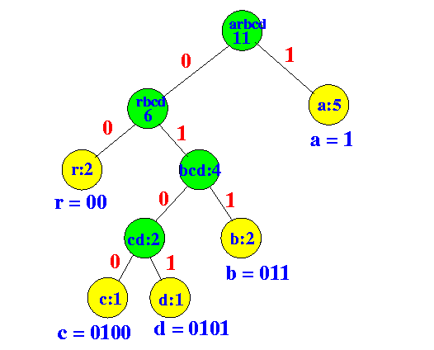
Introduction
History
In 1951, David A. Huffman and his MIT information theory classmates were given the choice of a term paper or a final exam.
The professor, Robert M. Fano, assigned a term paper on the problem of finding the most efficient binary code.
Huffman, unable to prove any codes were the most efficient, was about to give up and start studying for the final when he hit upon the idea of using a frequency-sorted binary tree and quickly proved this method the most efficient.

Slide 3
Objectives
To enunciate the concept of Huffman Coding and relate it to Discrete Mathematics
To implement Huffman trees using heaps and queues, and further compare their time complexities.
To apply and implement Huffman Coding for Image Compression

Slide 4
Huffman Coding in Discrete Mathematics
Huffman Coding provides a scheme to encode data in such a way that it is not immediately perceivable to a potential threat.
Huffman coding is an entropy encoding algorithm used for lossless data compression
It can be extensively used to encrypt data along with its compression.
Data can be either compressed and encrypted using existing compression algorithms or huffman compression can be applied with new symmetric cryptographic algorithms.
Hence Huffman coding is so closely related to cryptography, which is the study of creating security structures and passwords.
Also, since huffman encoding happens entirely in binary digits and involves the storage and communication of digital information, it uses concepts of information theory and theoretical computer science , hence entering the domain of discrete mathematics.

Slide 5
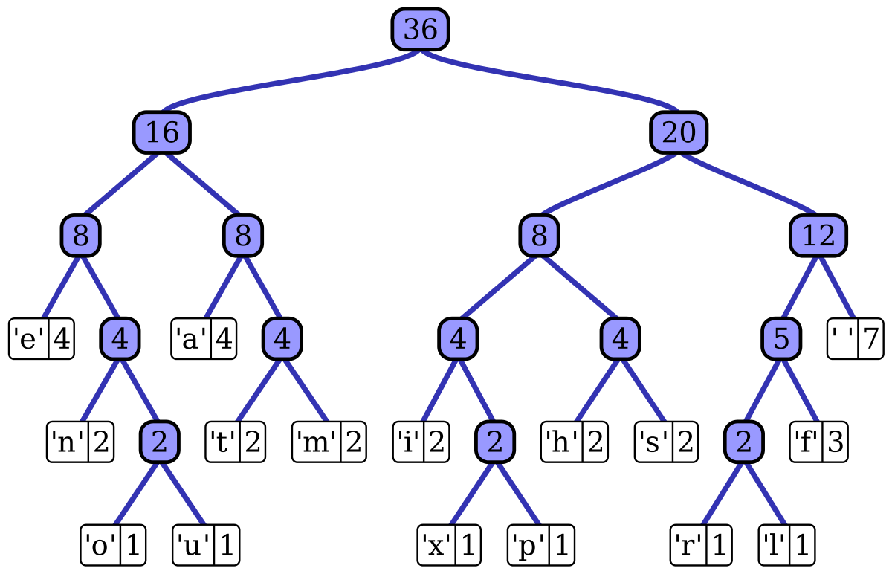
Introduction
What are Huffman Trees?
Huffman coding provides codes to characters such that the length of the code depends on the relative frequency or weight of the corresponding character.
Huffman tree or Huffman coding tree defines as a full binary tree in which each leaf of the tree corresponds to a letter in the given alphabet.
The Huffman tree is treated as the binary tree associated with minimum external path weight.

Slide 6
Concept
What is Huffman coding?
Huffman coding is a method for the construction of minimum-redundancy codes.
The output from Huffman's algorithm can be viewed as a variable-length code table for encoding a source symbol.
The algorithm derives this table from the estimated probability or frequency of occurrence (weight) for each possible value of the source symbol.
Huffman Coding is a technique of compressing data to reduce its size without losing any of the details.
Huffman code can be recognized with the help of Huffman coding trees or simply Huffman trees.
Huffman Coding prevents any ambiguity in the decoding process using the concept of prefix code ie. a code associated with a character should not be present in the prefix of any other code. The tree created helps in maintaining the property.

Slide 7
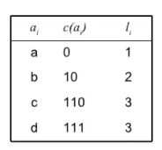
Concept
Problem Definition
Given
A set of symbols and their weights (usually proportional to probabilities).
Find
A prefix-free binary code (a set of codewords) with minimum expected codeword length (equivalently, a tree with minimum weighted path length from the root).
Example
A = { a , b , c , d }
P = { ½, ¼ ,⅛, ⅛} (Obtained from their frequencies)
Huffman Table
a_{i}- Character
c(a_{i})-Code
l_{i}- Number of bits

Slide 8
Basic Technique
Compression
The technique works by creating a binary tree of nodes. These can be stored in a regular array, the size of which depends on the number of symbols,
The process begins with the leaf nodes containing the probabilities of the symbol they represent. Then, the process takes the two nodes with smallest probability, and creates a new internal node having these two nodes as children.
We repeat this process until only one node remains, which is the root of the Huffman tree.
Decompression
The Huffman tree must be first reconstructed.
The process of decompression is then simply a matter of translating the stream of prefix codes to individual byte values, usually by traversing the Huffman tree node by node as each bit is read from the input stream (reaching a leaf node necessarily terminates the search for that particular byte value).

Slide 9

Basic Technique
Suppose the string below is to be sent over a network.
Each character occupies 8 bits. There are a total of 15 characters in the above string. Thus, a total of 8 * 15 = 120 bits are required to send this string.
Using the Huffman Coding technique, we can compress the string to a smaller size.
Huffman coding first creates a tree using the frequencies of the character and then generates code for each character.
Once the data is encoded, it has to be decoded. Decoding is done using the same tree.

Slide 10
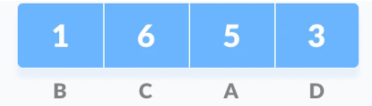
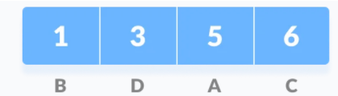
Basic Technique
Calculate the frequency of each character in the string.
Sort the characters in increasing order of the frequency. These are stored in a priority queue Q.

Slide 11
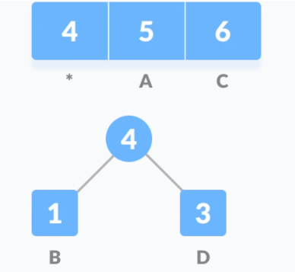
Basic Technique
3. Make each unique character as a leaf node.
4. Create an empty node z. Assign the minimum frequency to the left child of z and assign the second minimum frequency to the right child of z. Set the value of the z as the sum of the above two minimum frequencies.

Slide 12
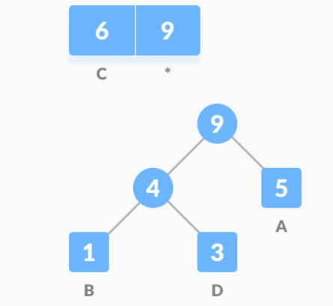
Basic Technique
5. Remove these two minimum frequencies from the Queue and add the sum into the list of frequencies (* denote the internal nodes in the figure above).
6. Insert node z into the tree.
7. Repeat steps 3 to 5 for all the characters.

Slide 13
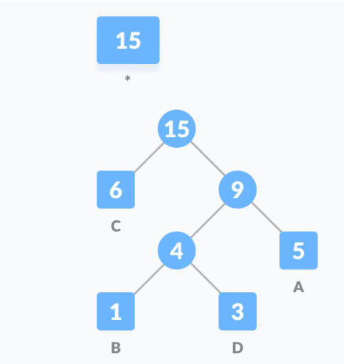
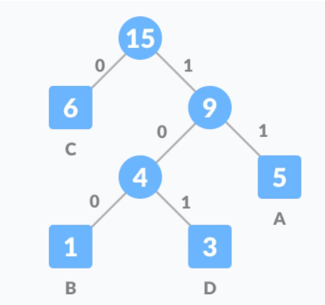
Basic Technique
8. For each non-leaf node, assign 0 to the left edge and 1 to the right edge.

Slide 14
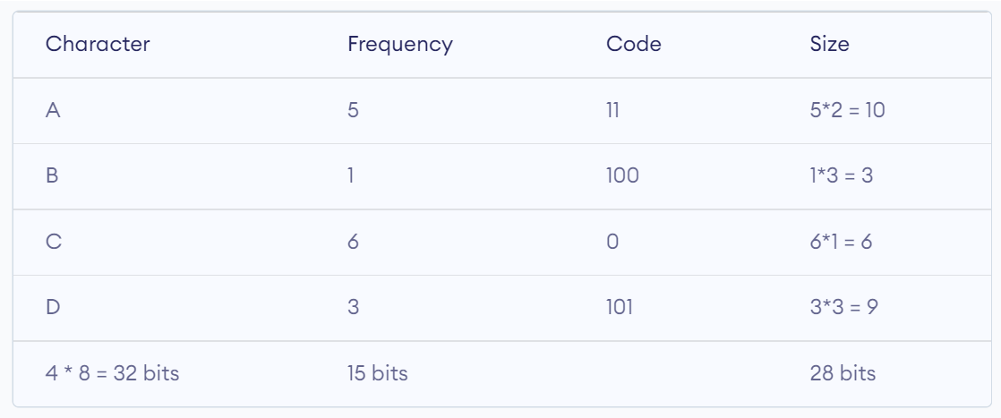
Basic Technique
For sending the above string over a network, we have to send the tree as well as the above compressed-code. The total size is given by the table below.
Without encoding, the total size of the string was 120 bits. After encoding the size is reduced to 32 + 15 + 28 = 75.

Slide 15
Algorithm-1
Here min-heaps are used to obtain the first two minimum nodes.
Input the string that has to be encoded. The string is condensed into a unique character array and a frequency array
A min heap is created with this data by first storing elements in an array and minheapifying it
The extractMin function is repeatedly used to extract the first two minimum frequencies(along with the associated characters) from the min heap and hence these frequencies are removed from the heap
A new node of the huffman tree is generated whose left and right children are respectively the two minimum frequencies.
The data of the node is fed to the min heap which is minHeapifyied once more.
The above steps are repeated until there is only one node in the heap which is the root node.

Slide 16
Decoding
Using huffman tree/huffman table generated and the encoded bits of the given string, the original string can be decoded. Hence while decoding we require the encoded message as well as huffman table which has to be stored or sent along with the encoded bits.
The algorithm for decoding is:
Take input as the encoded message and huffman tree
The huffman tree is traversed according to the the encoded message.
Starting from the root of tree, if the encoded bit is 0, the new root is the left child of the current root.
If the encoded bit is 1, new root is the right child of the current root
If we reach a leaf node, we print the value of the node and set the root to the actual root of the tree.

Slide 17
Algorithm-2
Huffman Coding with queues for sorted input
Applied when the given array is sorted
Queues are used for the execution of the programs
Leaf node is created for each character and frequency is increased on encounter with the character
The time complexity of this algorithm is O(n)
If the input is not sorted, it need to be sorted first before it can be processed by the above algorithm. Sorting can be done using heap-sort or merge-sort both of which run in Theta(nlogn). So, the overall time complexity becomes O(nlogn) for unsorted input.
This algorithm is applied only when the array is sorted else time complexity increases thus making it an efficient Huffman coding algorithm.

Slide 18
Algorithm-2
Algorithm
1. Create two empty queues.
2. Create a leaf node for each unique character and Enqueue it to the first queue in non-decreasing order of frequency. Initially second queue is empty.
3. Dequeue two nodes with the minimum frequency by examining the front of both queues. Repeat following steps two times
1. If second queue is empty, dequeue from first queue.
2. If first queue is empty, dequeue from second queue.
3. Else, compare the front of two queues and dequeue the minimum.
4. Create a new internal node with frequency equal to the sum of the two nodes frequencies. Make the first Dequeued node as its left child and the second Dequeued node as right child. Enqueue this node to second queue.
5. Repeat steps#3 and #4 while there is more than one node in the queues. The remaining node is the root node and the tree is complete.

Slide 19
Comparison
Time Complexity comparison between Huffman Coding using MinHeaps and Efficient Huffman Coding using queues
Time complexity of Huffman Coding with Min Heaps
The time complexity of the Huffman algorithm is O(nlogn). Using a heap to store the weight of each tree, each iteration requires O(logn) time to determine the cheapest weight and insert the new weight. There are O(n) iterations, one for each item.
Time complexity of Huffman Coding with Queues
If it is known that the given array is sorted then the time complexity of the algorithm reduces to O(n)

Slide 20
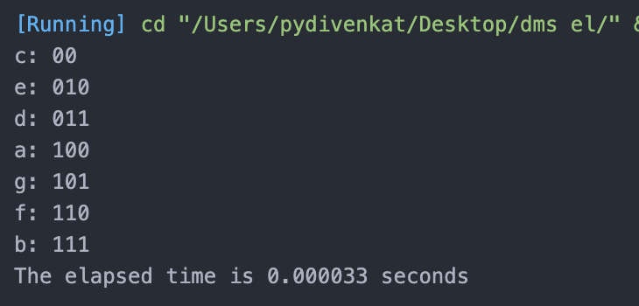
Algorithm-1
Time Complexity and time taken using min-Heaps which is O(nlogn)

Slide 21
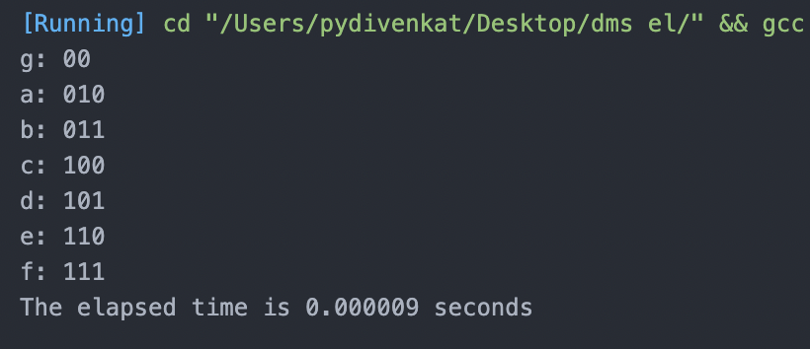
Algorithm-2
Huffman Table for each letter and time spent on generating the codes.where the time complexity is O(n).

Slide 22
Variations of Huffman Coding
n-ary Huffman coding
Adaptive Huffman coding
Huffman Template algorithm
Length-limited Huffman coding/minimum variance Huffman coding
Huffman coding with unequal letter costs
Optimal alphabetic binary trees(Hu-Tucker coding)
The canonical Huffman code

Slide 23
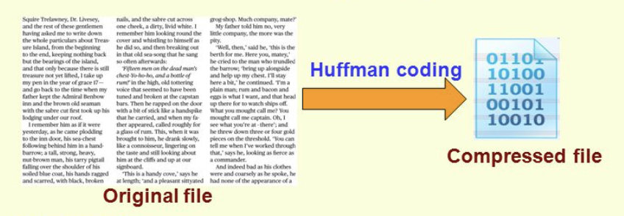

Applications
Huffman Coding technique is used for image compression
Huffman coding is used to compress data without any loss.It is a lossless data compression technique.
Huffman encoding is widely used in compression formats like GZIP, PKZIP (winzip) and BZIP2.
Multimedia codecs like JPEG, PNG and MP3 uses Huffman encoding (to be more precise the prefix codes)
Huffman encoding includes conjunction with cryptography.

Slide 24
Applications
Image Compression
Algorithm for compression(encoding) of images using huffman code
Step 1 :
Read the Image into a 2D array(image) using bmp format of image
Create a Histogram of the pixel intensity values present in the Image
Find the number of pixel intensity values having non-zero frequency of occurrence
Step 2 :
Define a struct which will contain the pixel intensity values(pix), their corresponding frequencies, the pointer to the left(*left) and right(*right) child nodes and also the string array for the Huffman code word(code).
Step 3 :
Define another Struct which will contain the pixel intensity values(pix), their corresponding frequencies and an additional field, which will be used for storing the position of new generated nodes

Slide 25
Applications
Step 4 :
Declaring an array of structs. Each element of the array corresponds to a node in the Huffman Tree.
Initialize the two arrays pix_freq and huffcodes with information of the leaf nodes.
Sorting the huffcodes array according to the frequency of occurrence of the pixel intensity values
Step 5 :
Start by combining the two nodes with lowest frequencies of occurrence and then replacing the two nodes by the new node. This process continues until we have a root node. The first parent node formed will be stored at index node in the array pix_freq and the subsequent parent nodes obtained will be stored at higher values of index.
Step 6 :
Backtrack from the root to the leaf nodes to assign code words
Encode the Image

Slide 26
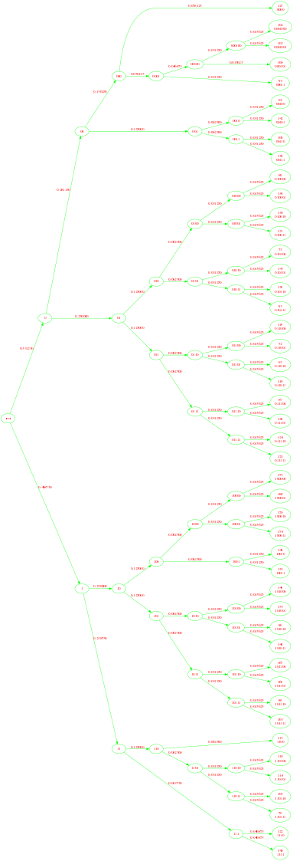

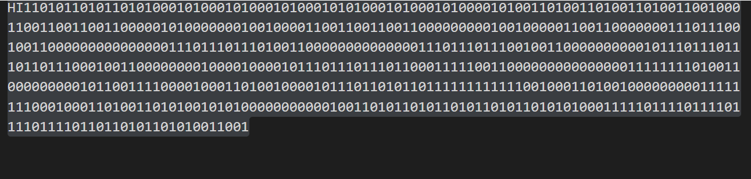
Application
Original 15x15 image
Huffman Tree Encoded Image(Compressed)

Slide 27
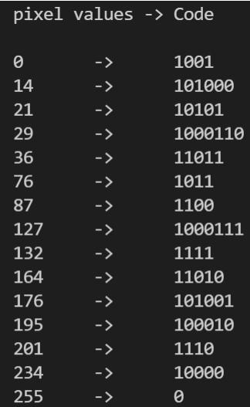
Application
Image compression proof
Original size of image(Test2.bmp) : 311 bytes
= (311 x 8) bits
= 2488 bits
Number of bits after encoding = 574 bits
Size of the huffman tree/ huffman code table
= 4 + 15 x 8 + 74
= 198 bits
Net size of data transmitted/stored = 574 + 198 = 772 bits
Total compression relative to original size of image
= ((2488 - 772)/2488) x 100 = 65%(approx)

Slide 28
Conclusion
Huffman Coding with the use of Huffman Trees provides a smart and efficient solution to compression of data without losing its quality.
As proved in the time complexity comparison, with sorted inputs it is more effective to use the algorithm with queues data structures over the min Heap implementation.
The image compression techniques provided by huffman coding can reduce the data to 55-65% of its original size making it a suitable method for data transmission as well as storage.
There is, of course, immense scope in the improvement and utilization of huffman coding and realization of its techniques like adaptive huffman coding, huffman coding with priority queues and n-ary techniques.

Slide 29
THANK YOU

